Slide 1
Chapter 3 Distributed Memory Programming with MPI

Slide 2
A distributed memory system

Slide 3
A shared memory system

Slide 4
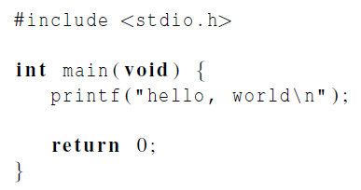

Hello World!
(a classic)

Slide 5
Identifying MPI processes
Common practice to identify processes by nonnegative integer ranks.
p processes are numbered 0, 1, 2, .. p-1

Slide 6

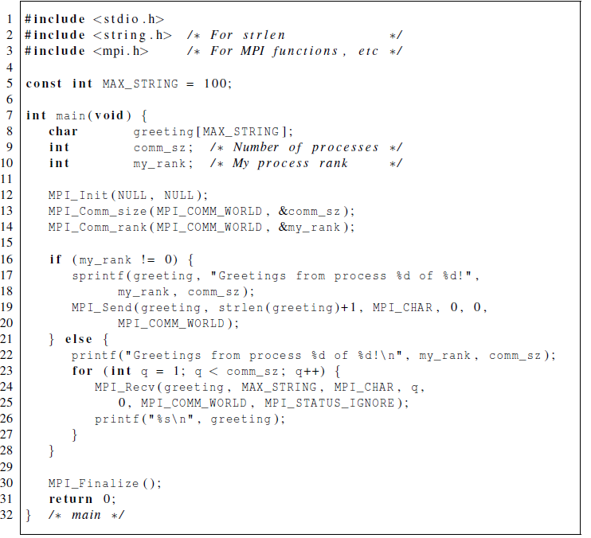
Our first MPI program

Slide 7
Compilation
wrapper script to compile
source file
mpiicc -g -Wall -o mpi_hello mpi_hello.c
produce debugging
information
create this executable file name
(as opposed to default a.out)
turns on all warnings

Slide 8
Execution
mpiexec -n <number of processes> <executable>
mpiexec -n 1 ./mpi_hello
run with 1 process
mpiexec -n 4 ./mpi_hello
run with 4 processes

Slide 9
Execution
mpiexec -n 1 ./mpi_hello
Greetings from process 0 of 1 !
mpiexec -n 4 ./mpi_hello
Greetings from process 0 of 4 !
Greetings from process 1 of 4 !
Greetings from process 2 of 4 !
Greetings from process 3 of 4 !

Slide 10
MPI Programs
Written in C.
Has main.
Uses stdio.h, string.h, etc.
Need to add mpi.h header file.
Identifiers defined by MPI start with “MPI_”.
First letter following underscore is uppercase.
For function names and MPI-defined types.
Helps to avoid confusion.

Slide 11
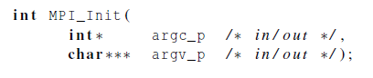
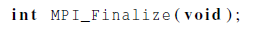
MPI Components
MPI_Init
Tells MPI to do all the necessary setup.
MPI_Finalize
Tells MPI we’re done, so clean up anything allocated for this program.

Slide 12
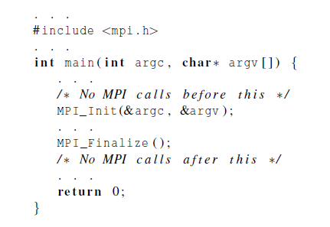
Basic Outline

Slide 13
Communicators
A collection of processes that can send messages to each other.
MPI_Init defines a communicator that consists of all the processes created when the program is started.
Called MPI_COMM_WORLD.

Slide 14

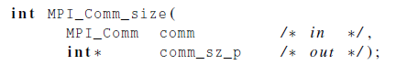
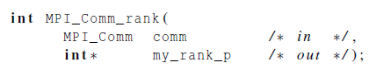
Communicators
number of processes in the communicator
my rank (the process making this call)

Slide 15
SPMD
Single-Program Multiple-Data
We compile one program.
Process 0 does something different.
Receives messages and prints them while the other processes do the work.
The if-else construct makes our program SPMD.

Slide 16
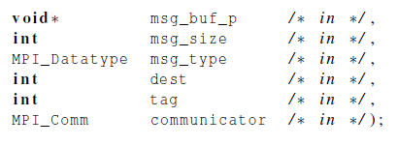
Communication

Slide 17
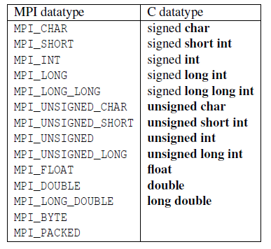
Data types

Slide 18
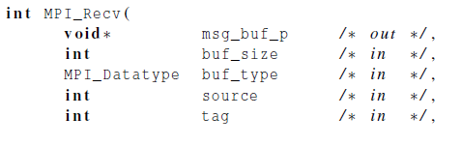
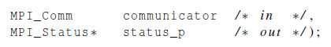
Communication

Slide 19

Message matching
r
MPI_Send
src = q
MPI_Recv
dest = r
q

Slide 20

Receiving messages
A receiver can get a message without knowing:
the amount of data in the message,
the sender of the message,
or the tag of the message.

Slide 21
status_p argument
MPI_Status*
MPI_Status* status;
status.MPI_SOURCE
status.MPI_TAG
MPI_SOURCE
MPI_TAG
MPI_ERROR

Slide 22
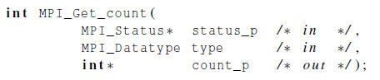

How much data am I receiving?

Slide 23

Issues with send and receive
Exact behavior is determined by the MPI implementation.
MPI_Send may behave differently with regard to buffer size, cutoffs and blocking.
MPI_Recv always blocks until a matching message is received.
Know your implementation; don’t make assumptions!

Slide 24

Trapezoidal rule in mpi

Slide 25
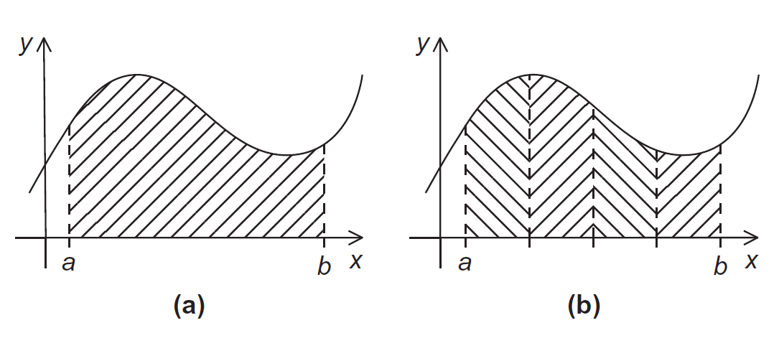
The Trapezoidal Rule

Slide 26
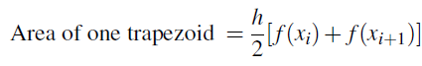
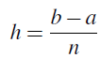
The Trapezoidal Rule

Slide 27
One trapezoid

Slide 28
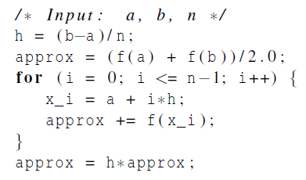
Pseudo-code for a serial program

Slide 29
Parallelizing the Trapezoidal Rule
Partition problem solution into tasks.
Identify communication channels between tasks.
Aggregate tasks into composite tasks.
Map composite tasks to cores.

Slide 30
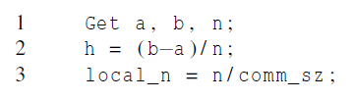
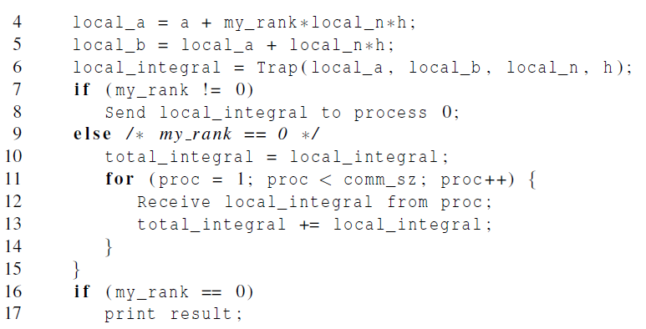
Parallel pseudo-code

Slide 31
Tasks and communications for Trapezoidal Rule

Slide 32
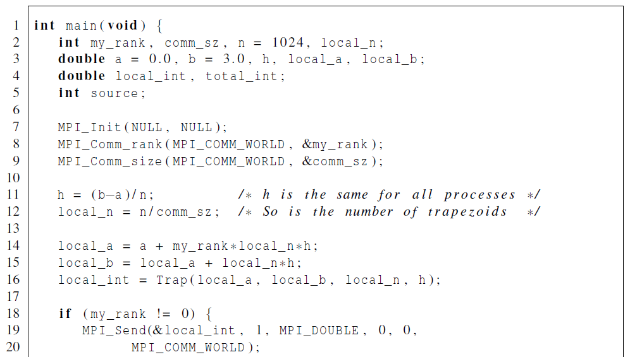
First version (1)

Slide 33
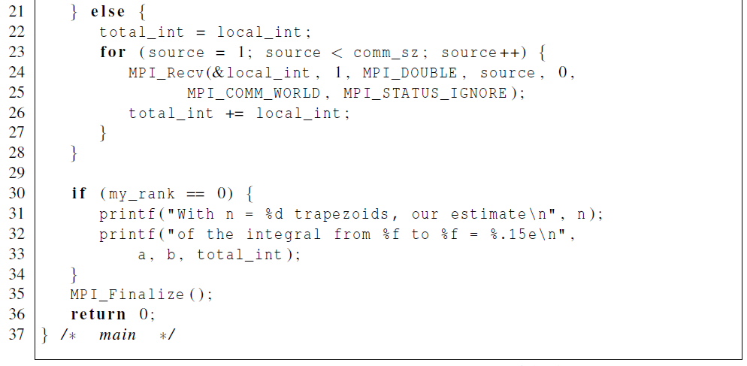
First version (2)

Slide 34
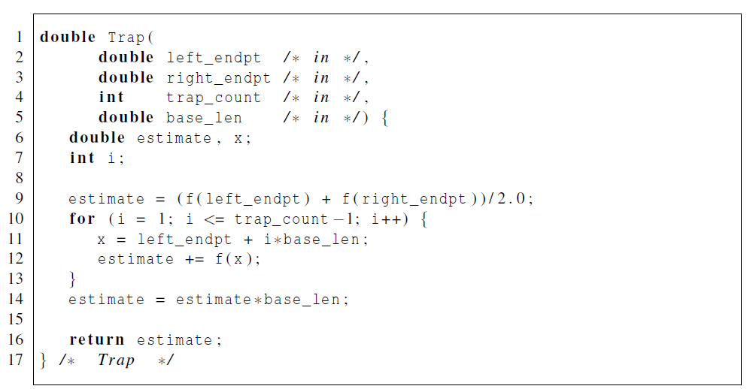
First version (3)

Slide 35
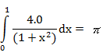
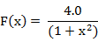
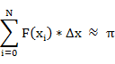
Program example
4.0
0
1.0

Slide 36
Program example: original code
#include <stdio.h>
#define f(x) (4.0/(1.0+x*x))
void main(int argc, char ** argv){ int i, n = 10000000;
double w, x, sum, pi;
w = 1.0/n;
sum = 0.0;
for(i=1; i<= n; i++){
x = w*(double)(i – 0.5);
sum += f(x); }
pi = w*sum;
printf(“PI : %.16f”, pi);
}

Slide 37
Program example: parallel code(1/2)
#include “mpi.h”
#include <stdio.h>
#define f(x) (4.0/(1.0+x*x))
void main(int argc, char *argv[]){
int myid, t_process, i, n = 10000000;
double mypi, pi, h, sum, x, recv_pi;
MPI_Init(&argc, &argv);
MPI_Comm_size(MPI_COMM_WORLD, &t_process);
MPI_Comm_rank(MPI_COMM_WORLD, &myid);
h = 1.0/(double) n; sum = 0.0;
for(i = myid +1 ; i <= n ; i+= t_process){
x = h*(double) (i– 0.5);
sum += f(x);
}

Slide 38
Program example: parallel code(2/2)
mypi = h*sum;
if(myid == 0){ pi = 0;
MPI_Status status;
for(i=1; i< t_process; i++){
MPI_Recv(&recv_pi, 1, MPI_DOUBLE, i, 1, MPI_COMM_WORLD, &status);
pi += recv_pi;
}
printf(“PI : %.16f\n”, pi);
}
else MPI_Send(&mypi, 1, MPI_DOUBLE, 0, 1, MPI_COMM_WORLD);
MPI_Finalize();
}

Slide 39

2
2

Slide 40
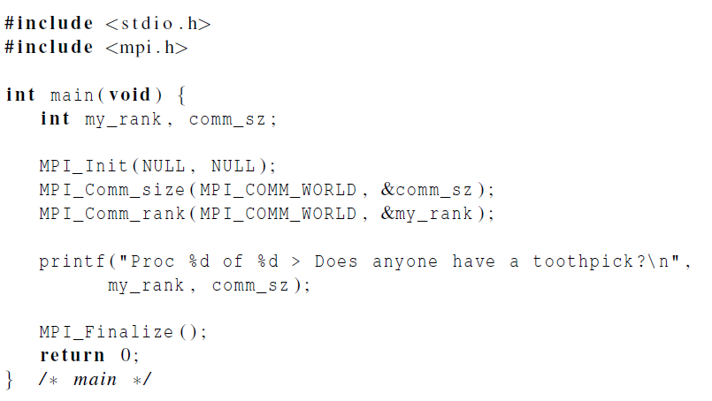
Dealing with I/O
Each process just prints a message.

Slide 41
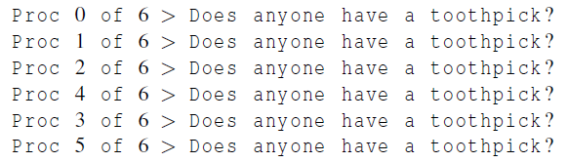

Running with 6 processes
unpredictable output

Slide 42
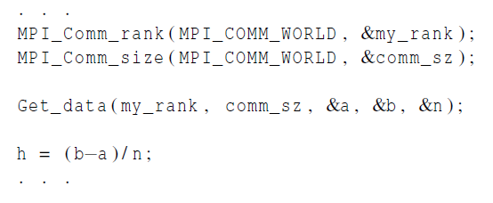
Input
Most MPI implementations only allow process 0 in MPI_COMM_WORLD access to stdin.
Process 0 must read the data (scanf) and send to the other processes.

Slide 43
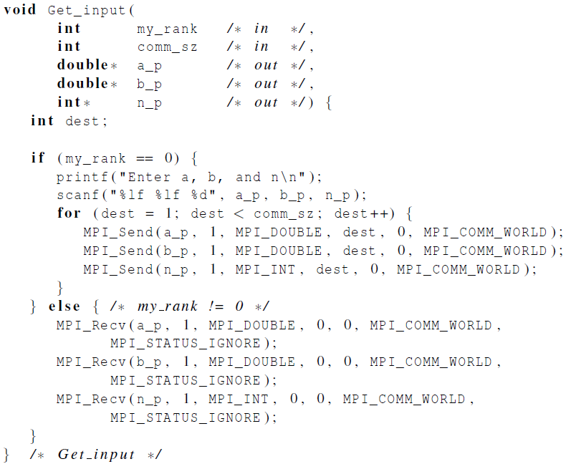
Function for reading user input

Slide 44

Collective communication

Slide 45
Tree-structured communication
In the first phase: (a) Process 1 sends to 0, 3 sends to 2, 5 sends to 4, and 7 sends to 6. (b) Processes 0, 2, 4, and 6 add in the received values. (c) Processes 2 and 6 send their new values to processes 0 and 4, respectively. (d) Processes 0 and 4 add the received values into their new values.
(a) Process 4 sends its newest value to process 0. (b) Process 0 adds the received value to its newest value.

Slide 46
A tree-structured global sum

Slide 47
An alternative tree-structured global sum

Slide 48
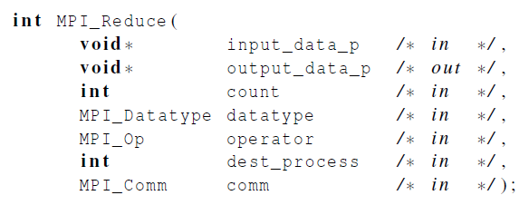
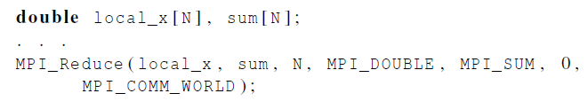
MPI_Reduce

Slide 49
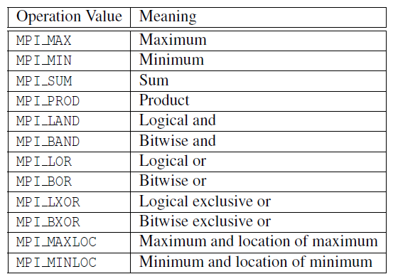
Predefined reduction operators in MPI

Slide 50
Collective vs. Point-to-Point Communications
All the processes in the communicator must call the same collective function.
For example, a program that attempts to match a call to MPI_Reduce on one process with a call to MPI_Recv on another process is erroneous, and, in all likelihood, the program will hang or crash.

Slide 51
Collective vs. Point-to-Point Communications
The arguments passed by each process to an MPI collective communication must be “compatible.”
For example, if one process passes in 0 as the dest_process and another passes in 1, then the outcome of a call to MPI_Reduce is erroneous, and, once again, the program is likely to hang or crash.

Slide 52
Collective vs. Point-to-Point Communications
The output_data_p argument is only used on dest_process.
However, all of the processes still need to pass in an actual argument corresponding to output_data_p, even if it’s just NULL.

Slide 53
Collective vs. Point-to-Point Communications
Point-to-point communications are matched on the basis of tags and communicators.
Collective communications don’t use tags.
They’re matched solely on the basis of the communicator and the order in which they’re called.

Slide 54
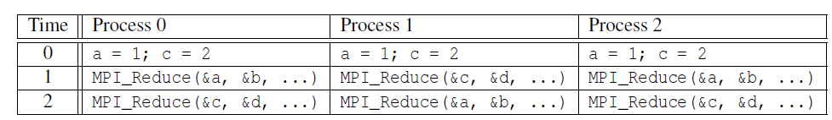
Example (1)
Multiple calls to MPI_Reduce

Slide 55
Example (2)
Suppose that each process calls MPI_Reduce with operator MPI_SUM, and destination process 0.
At first glance, it might seem that after the two calls to MPI_Reduce, the value of b will be 3, and the value of d will be 6.

Slide 56
Example (3)
However, the names of the memory locations are irrelevant to the matching of the calls to MPI_Reduce.
The order of the calls will determine the matching so the value stored in b will be 1+2+1 = 4, and the value stored in d will be 2+1+2 = 5.

Slide 57
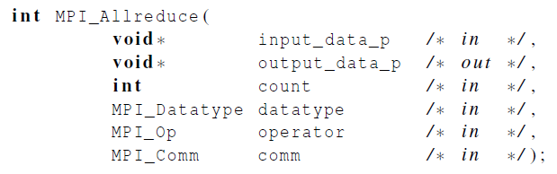
MPI_Allreduce
Useful in a situation in which all of the processes need the result of a global sum in order to complete some larger computation.

Slide 58
A global sum followed by distribution of the result.

Slide 59

A butterfly-structured global sum.

Slide 60
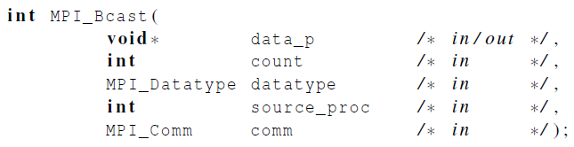
Broadcast
Data belonging to a single process is sent to all of the processes in the communicator.

Slide 61

A tree-structured broadcast.

Slide 62
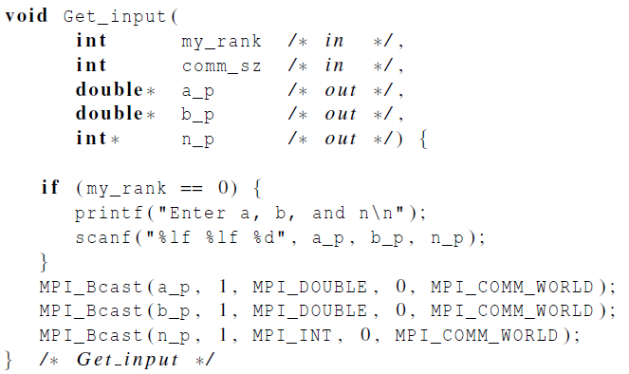
A version of Get_input that uses MPI_Bcast

Slide 63
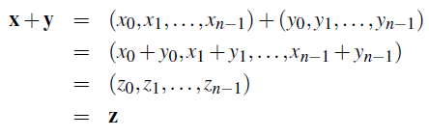
Data distributions
Compute a vector sum.

Slide 64
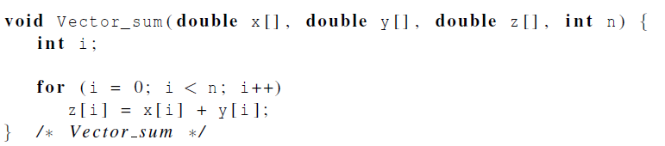
Serial implementation of vector addition

Slide 65
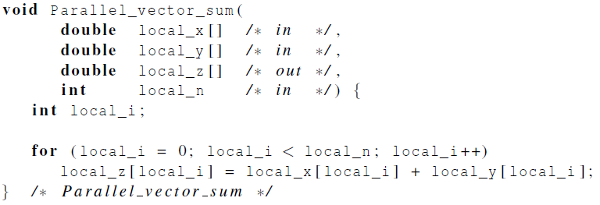
Parallel implementation of vector addition

Slide 66
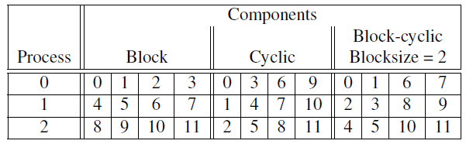
Different partitions of a 12-component vector among 3 processes

Slide 67
Partitioning options
Block partitioning
Assign blocks of consecutive components to each process.
Cyclic partitioning
Assign components in a round robin fashion.
Block-cyclic partitioning
Use a cyclic distribution of blocks of components.

Slide 68
P1
P2
P3
P4
Block partitioning
Cyclic partitioning
Block-cyclic partitioning

Slide 69
Two-Dimensional Block Cyclic Data Distribution
P1
P2
P3
P4
Grid
Block

Slide 70
Two-Dimensional Block Cyclic Data Distribution
P1
Grid
Block
P2
P3
P4

Slide 71
Two-Dimensional Block Cyclic Data Distribution
P1
P2
P3
P4
Grid
Block

Slide 72
Two-Dimensional Block Cyclic Data Distribution
P1
P2
Grid
P3
P4
Block

Slide 73
Two-Dimensional Block Cyclic Data Distribution
P1
P2
Grid
P3
P4
Block

Slide 74






Slide 75
Message transmission time = l + n / b

Slide 76
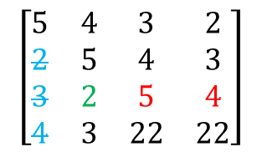
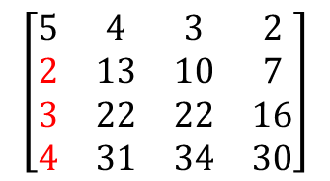
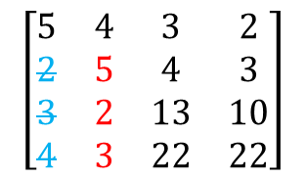
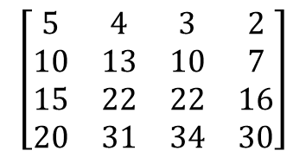
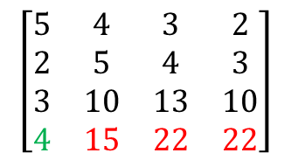
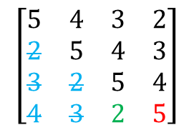
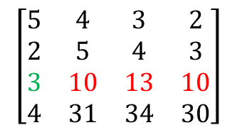
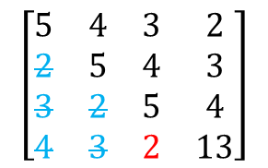
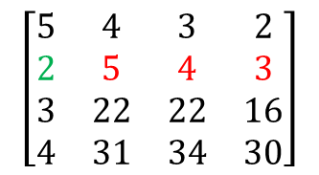
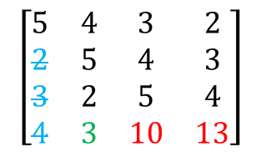
$$\left[\begin{matrix}5 & 4 & 3 & 2 \\ 10 & 13 & 10 & 7 \\ 15 & 22 & 22 & 16 \\ 20 & 31 & 34 & 30\end{matrix}\right]$$
$$\left[\begin{matrix}5 & 4 & 3 & 2 \\ 2 & 5 & 4 & 3 \\ 3 & 22 & 22 & 16 \\ 4 & 31 & 34 & 30\end{matrix}\right]$$
$$\left[\begin{matrix}5 & 4 & 3 & 2 \\ 2 & 5 & 4 & 3 \\ 3 & 2 & 13 & 10 \\ 4 & 3 & 22 & 22\end{matrix}\right]$$
$$\left[\begin{matrix}5 & 4 & 3 & 2 \\ 2 & 13 & 10 & 7 \\ 3 & 22 & 22 & 16 \\ 4 & 31 & 34 & 30\end{matrix}\right]$$
$$\left[\begin{matrix}5 & 4 & 3 & 2 \\ 2 & 5 & 4 & 3 \\ 3 & 10 & 13 & 10 \\ 4 & 31 & 34 & 30\end{matrix}\right]$$
$$\left[\begin{matrix}5 & 4 & 3 & 2 \\ 2 & 5 & 4 & 3 \\ 3 & 2 & 5 & 4 \\ 4 & 3 & 22 & 22\end{matrix}\right]$$
$$\left[\begin{matrix}5 & 4 & 3 & 2 \\ 2 & 5 & 4 & 3 \\ 3 & 2 & 5 & 4 \\ 4 & 3 & 10 & 13\end{matrix}\right]$$
$$\left[\begin{matrix}5 & 4 & 3 & 2 \\ 2 & 5 & 4 & 3 \\ 3 & 10 & 13 & 10 \\ 4 & 15 & 22 & 22\end{matrix}\right]$$
$$\left[\begin{matrix}5 & 4 & 3 & 2 \\ 2 & 5 & 4 & 3 \\ 3 & 2 & 5 & 4 \\ 4 & 3 & 2 & 13\end{matrix}\right]$$
for k=1 to m-1 do
for i=k+1 to m do
a_{ik} = a_{ik} / a_{kk}
for j=k+1 to m do
for i=k+1 to m do
a_{ij} = a_{ij}- a_{ik}*a_{kj}
$$\left[\begin{matrix}5 & 4 & 3 & 2 \\ 2 & 5 & 4 & 3 \\ 3 & 2 & 5 & 4 \\ 4 & 3 & 2 & 5\end{matrix}\right]$$

Slide 77
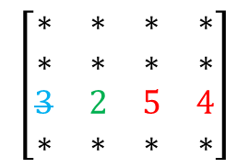








$$\left[\begin{matrix}5 & 4 & 3 & 2 \\ 10 & 13 & 10 & 7 \\ 15 & 22 & 22 & 16 \\ 20 & 31 & 34 & 30\end{matrix}\right]$$
$$\left[\begin{matrix}∗ & ∗ & ∗ & ∗ \\ 2 & 5 & 4 & 3 \\ ∗ & ∗ & ∗ & ∗ \\ ∗ & ∗ & ∗ & ∗\end{matrix}\right]$$
$$\left[\begin{matrix}5 & 4 & 3 & 2 \\ 2 & 5 & 4 & 3 \\ 3 & 2 & 13 & 10 \\ 4 & 3 & 22 & 22\end{matrix}\right]$$
$$\left[\begin{matrix}5 & 4 & 3 & 2 \\ 2 & 13 & 10 & 7 \\ 3 & 22 & 22 & 16 \\ 4 & 31 & 34 & 30\end{matrix}\right]$$
$$\left[\begin{matrix}∗ & ∗ & ∗ & ∗ \\ ∗ & ∗ & ∗ & ∗ \\ 3 & 10 & 13 & 10 \\ ∗ & ∗ & ∗ & ∗\end{matrix}\right]$$
$$\left[\begin{matrix}∗ & ∗ & ∗ & ∗ \\ ∗ & ∗ & ∗ & ∗ \\ 3 & 2 & 5 & 4 \\ ∗ & ∗ & ∗ & ∗\end{matrix}\right]$$
$$\left[\begin{matrix}∗ & ∗ & ∗ & ∗ \\ ∗ & ∗ & ∗ & ∗ \\ ∗ & ∗ & ∗ & ∗ \\ 4 & 3 & 10 & 13\end{matrix}\right]$$
$$\left[\begin{matrix}∗ & ∗ & ∗ & ∗ \\ ∗ & ∗ & ∗ & ∗ \\ ∗ & ∗ & ∗ & ∗ \\ 4 & 15 & 22 & 22\end{matrix}\right]$$
$$\left[\begin{matrix}5 & 4 & 3 & 2 \\ 2 & 5 & 4 & 3 \\ 3 & 2 & 5 & 4 \\ 4 & 3 & 2 & 13\end{matrix}\right]$$
for k=1 to m-1 do
for i=k+1 to m do
a_{ik} = a_{ik} / a_{kk}
for j=k+1 to m do
for i=k+1 to m do
a_{ij} = a_{ij}- a_{ik}*a_{kj}
$$\left[\begin{matrix}5 & 4 & 3 & 2 \\ 2 & 5 & 4 & 3 \\ 3 & 2 & 5 & 4 \\ 4 & 3 & 2 & 5\end{matrix}\right]$$

Slide 78
T_{1,1}
T_{1,2}
T_{1,3}
T_{1,4}
T_{1,5}
T_{2,2}
T_{2,3}
T_{2,4}
T_{2,5}
T_{3,3}
for k=1 to m-1 do
T_{k,k} : { for i=k+1 to m do
a_{ik} = a_{ik} / a_{kk} }
for j=k+1 to m do
T_{k,j} : { for i=k+1 to m do
a_{ij} = a_{ij}- a_{ik}*a_{kj} }
T_{3,4}
T_{3,5}
T_{4,4}
T_{4,5}

Slide 79
Linpack Benchmark
Problems sizes
Block sizes
Specify the number of process rows and columns (Ps × Qs)
P1
P2
P1
P2
P3
P4
Grid
Grid
P3
P4

Slide 80

Scatter
MPI_Scatter can be used in a function that reads in an entire vector on process 0 but only sends the needed components to each of the other processes.

Slide 81
MPI_Scatter
int Sdata[8] = {1,2,3,4,5,6,7,8}, Rdata[2];
int Send_cnt = 2, Recv_cnt = 2, src = 0;
MPI_Scatter( Sdata, Send_cnt, MPI_INTEGER, Rdata, Recv_cnt,
MPI_INTEGER , src, MPI_COMM_WORLD);
CPU₀
CPU₁
CPU₂
CPU₃
Rdata
[1,2]
Rdata
[3,4]
Rdata
[5,6]
Rdata
[7,8]
Sdata
[1,2,3,4,5,6,7,8]
[1,2]
[3,4]
[5,6]
[7,8]
MPI_Scatter
Notes:
Init: CPU0擁有Sdata
1: 程式運行到MPI_Scatter
2: 將Sdata等份切割，並在各CPU中準備接收的Rdata位置
3: 由CPU0發送切割好的資料給各個CPU

Slide 82

Reading and distributing a vector

Slide 83

Gather
Collect all of the components of the vector onto process 0, and then process 0 can process all of the components.

Slide 84
MPI_Gather
int Send_cnt = 2, Recv_cnt = 2, dest = 0;
MPI_Gather ( Sdata, Send_cnt, MPI_INTEGER, Rdata, Recv_cnt,
MPI_INTEGER , dest, MPI_COMM_WORLD);
CPU₀
CPU₁
CPU₂
CPU₃
[1,2]
[3,4]
[5,6]
[7,8]
Sdata
Sdata
Sdata
Sdata
Rdata
[1,2,3,4,5,6,7,8]
MPI_Gather
Notes:
Init: 各個CPU擁有各自的Sdata
1: 執行到MPI_Gather
2: 在CPU0中準備接收Rdata的位置
3: 收集來自各個CPU傳來的資料

Slide 85

Print a distributed vector (1)

Slide 86

Print a distributed vector (2)

Slide 87

Allgather
Concatenates the contents of each process’ send_buf_p and stores this in each process’ recv_buf_p.
As usual, recv_count is the amount of data being received from each process.

Slide 88
MPI_Allgather
int Send_cnt = 2, Recv_cnt = 8;
MPI_Allgather ( Sdata, Send_cnt, MPI_INTEGER, Rdata, Recv_cnt,
MPI_INTEGER , MPI_COMM_WORLD);
CPU₀
CPU₁
CPU₂
CPU₃
Sdata
[1,2]
Sdata
[3,4]
Sdata
[5,6]
Sdata
[7,8]
Rdata
Rdata
Rdata
Rdata
[1,2,3,4,5,6,7,8]
[1,2,3,4,5,6,7,8]
[1,2,3,4,5,6,7,8]
[1,2,3,4,5,6,7,8]
MPI_Allgather
Notes:
Init: 各CPU擁有各自的Sdata
1: 執行到MPI_Allgather
2: 在各CPU中準備Rdata的空間準備接收資料
3: 資料傳送為循序發送 由CPU0開始對所有CPU發送資料
4: 各CPU收集資料

Slide 89
MPI_Gatherv
int dest = 0, Send_cnt = sizeof(Sbuf);
int rc[4] = {3,1,2,2}, disp[4] = {0,3,4,6};
MPI_Gatherv ( Sbuf, Send_cnt, MPI_INTEGER, Rbuf, rc, disp,
MPI_INTEGER , dest, MPI_COMM_WORLD);
CPU₀
CPU₁
CPU₂
CPU₃
[1,2,3]
[4]
[5,6]
[7,8]
Sdata
Sdata
Sdata
Sdata
Rdata
[1,2,3,4,5,6,7,8]
MPI_Gatherv
Notes:
Init: 各CPU擁有各自Sbuf
1: 執行到MPI_Gatherv
2: 接收之CPU準備Rbuf以便接收資料
3: 接收之CPU依據rc及disp來接收資料並且擺放到應該擺的位置

Slide 90
MPI_Scatterv
int MPI_Scatterv(const void *sendbuf, const int *sendcounts, const int *displs, MPI_Datatype sendtype, void *recvbuf, int recvcount, MPI_Datatype recvtype, int root, MPI_Comm comm)

Slide 91

Matrix-vector multiplication
i-th component of y
Dot product of the ith row of A with x.

Slide 92

Matrix-vector multiplication

Slide 93


Multiply a matrix by a vector
Serial pseudo-code

Slide 94


C style arrays
stored as

Slide 95

Serial matrix-vector multiplication

Slide 96

An MPI matrix-vector multiplication function (1)

Slide 97

An MPI matrix-vector multiplication function (2)

Slide 98

Mpi derived datatypes

Slide 99
Derived datatypes
Used to represent any collection of data items in memory by storing both the types of the items and their relative locations in memory.
The idea is that if a function that sends data knows this information about a collection of data items, it can collect the items from memory before they are sent.
Similarly, a function that receives data can distribute the items into their correct destinations in memory when they’re received.

Slide 100



Slide 101

Derived datatypes
Formally, consists of a sequence of basic MPI data types together with a displacement for each of the data types.
Trapezoidal Rule example:

Slide 102

MPI_Type create_struct
Builds a derived datatype that consists of individual elements that have different basic types.

Slide 103

MPI_Get_address
Returns the address of the memory location referenced by location_p.
The special type MPI_Aint is an integer type that is big enough to store an address on the system.

Slide 104
MPI_Type_commit
Allows the MPI implementation to optimize its internal representation of the datatype for use in communication functions.

Slide 105
MPI_Type_free
When we’re finished with our new type, this frees any additional storage used.

Slide 106


Slide 107


Slide 108
MPI_Type_contiguous
Include a fixed amount of continuous array which have the same data type.
int err, count;
MPI_Datatype oldtype, newtype;
err = MPI_Type_contiguous( count, oldtype, &newtype) ;
count | The size of array.
oldtype | The old data type.
newtype | The new data type.

Slide 109
MPI_Type_contiguous
int count = 3;
MPI_Datatype newtype;
err = MPI_Type_contiguous( count, MPI_INTEGER, &newtype);
Old:
New:
INTEGER
0
1
2
INTEGER
INTEGER
INTEGER
element₀
element₁
element₂

Slide 110
MPI_Type_vector
Include a fixed size of interval of discontinuous array which have the same data type.
int err, count, blocklength, stride;
MPI_Datatype oldtype, newtype;
err = MPI_Type_vector( count, blocklength, stride, oldtype, &newtype);
count | The amount of block.
blocklength | The amount of data with old data type at a block.
stride | The distance of block, and using old data type as unit.
oldtype | The old data type.
newtype | The new data type.

Slide 111
MPI_Type_vector
int count = 2, blocklength = 2, stride = 3;
MPI_Datatype newtype;
MPI_Type_vector( count, blocklength, stride, MPI_INTEGER, &newtype);
Old:
New:
INTEGER
0
1
2
3
4
5
INTEGER
INTEGER
INTEGER
INTEGER
INTEGER
INTEGER
element₀
element₁

Slide 112
MPI_Type_indexed
Include an any distance and discontinuous array which have the same data type.
int err, count, length[], disp[];
MPI_Datatype oldtype, newtype;
err = MPI_Type_indexed( count, length, disp, oldtype, &newtype);
count | The amount of block.
length | The amount of data with old data type at a block.
disp | The location of block, and using old data type as unit.
oldtype | The old data type.
newtype | The new data type.

Slide 113
MPI_Type_indexed
int count = 3, length[3] = {1,3,2}, disp[3] = {0,3,7};
MPI_Datatype newtype;
MPI_Type_indexed( count, length, disp, MPI_INTEGER, &newtype);
Old:
New:
INT
0
1
2
3
4
5
6
7
8
INT
INT
INT
INT
INT
INT
INT
INT
INT
element₀
element₁
element₂

Slide 114
MPI_Datatype_struct
Any combination of data types.
int err, count, length[];
MPI_Aint disp[];
MPI_Datatype oldtype[], newtype;
err = MPI_Type_struct( count, length, disp, oldtype, &newtype);
count | The amount of block.
length | The amount of data with old data type at a block.
disp | The location of block, and using type as unit.
oldtype | The old data types.
newtype | The new data type.

Slide 115
MPI_Datatype_struct
int count = 2, length[2] = {2,4}, disp[2] = {0, extent(MPI_INTEGER)*2};
MPI_Datatype oldtype[2] = {MPI_INTEGER, MPI_DOUBLE}, newtype;
MPI_Type_struct( count, length, disp, oldtype, &newtype);
Old:
New:
INT
Double
INT
INT
Double
Double
Double
Double
element₀
element₁

Slide 116
MPI_Type_extent
For using to know the memory size of a specifies data type .
MPI_Datatype type;
MPI_Aint extent;
int err = MPI_Type_extent( type, &extent);
type | Data type.
extent | The memory size of an data type unit.

Slide 117

Performance evaluation

Slide 118


Elapsed parallel time
Returns the number of seconds that have elapsed since some time in the past.

Slide 119


Elapsed serial time
In this case, you don’t need to link in the MPI libraries.
Returns time in microseconds elapsed from some point in the past.

Slide 120

Elapsed serial time

Slide 121

MPI_Barrier
Ensures that no process will return from calling it until every process in the communicator has started calling it.

Slide 122


MPI_Barrier

Slide 123

Run-times of serial and parallel matrix-vector multiplication
(Seconds)

Slide 124

Speedup

Slide 125

Efficiency

Slide 126

Speedups of Parallel Matrix-Vector Multiplication

Slide 127

Efficiencies of Parallel Matrix-Vector Multiplication

Slide 128
A parallel sorting algorithm

Slide 129
Sorting
n keys and p = comm sz processes.
n/p keys assigned to each process.
No restrictions on which keys are assigned to which processes.
When the algorithm terminates:
The keys assigned to each process should be sorted in (say) increasing order.
If 0 ≤ q < r < p, then each key assigned to process q should be less than or equal to every key assigned to process r.

Slide 130



Serial bubble sort

Slide 131
Data dependence (bubble sort)
list_length
a
b
6
5
4
3
2
0
1
2
3
4
i

Slide 132


Odd-even transposition sort
A sequence of phases.
Even phases, compare swaps:
Odd phases, compare swaps:
…
Even phase
Odd phase
Even phase
Odd phase
…

Slide 133
Communications among tasks in odd-even sort
Tasks determining a[i] are labeled with a[i].

Slide 134
Example
Start: 5, 9, 4, 3
Even phase: compare-swap (5,9) and (4,3) getting the list 5, 9, 3, 4
Odd phase: compare-swap (9,3) getting the list 5, 3, 9, 4
Even phase: compare-swap (5,3) and (9,4) getting the list 3, 5, 4, 9
Odd phase: compare-swap (5,4) getting the list 3, 4, 5, 9

Slide 135

Serial odd-even transposition sort

Slide 136
Data dependence (odd-even transposition sort)
phase
1, 2, 3, 4, 5, 6
5
1, (3, 2), (5, 4), 6
4
(3, 1), (5, 2), (6, 4)
3
3, (5, 1), (6, 2), 4
2
(5, 3), (6, 1), (4, 2)
1
5, (6, 3), (4, 1), 2
0
(6, 5), (4, 3), (2, 1)
1
2
3
4
5
i

Slide 137

Parallel odd-even transposition sort
( )
( )
( )
( )
( )
( )

Slide 138

Pseudo-code

Slide 139

Compute_partner

Slide 140
Safety in MPI programs
The MPI standard allows MPI_Send to behave in two different ways:
it can simply copy the message into an MPI managed buffer and return,
or it can block until the matching call to MPI_Recv starts.

Slide 141
Safety in MPI programs
Many implementations of MPI set a threshold at which the system switches from buffering to blocking.
Relatively small messages will be buffered by MPI_Send.
Larger messages, will cause it to block.

Slide 142
Safety in MPI programs
If the MPI_Send executed by each process blocks, no process will be able to start executing a call to MPI_Recv, and the program will hang or deadlock.
Each process is blocked waiting for an event that will never happen.
(see pseudo-code)

Slide 143
Safety in MPI programs
A program that relies on MPI provided buffering is said to be unsafe.
Such a program may run without problems for various sets of input, but it may hang or crash with other sets.

Slide 144


MPI_Ssend
An alternative to MPI_Send defined by the MPI standard.
The extra “s” stands for synchronous and MPI_Ssend is guaranteed to block until the matching receive starts.

Slide 145


Restructuring communication

Slide 146
MPI_Sendrecv
An alternative to scheduling the communications ourselves.
Carries out a blocking send and a receive in a single call.
The dest and the source can be the same or different.
Especially useful because MPI schedules the communications so that the program won’t hang or crash.

Slide 147


MPI_Sendrecv

Slide 148
Safe communication with five processes

Slide 149

Parallel odd-even transposition sort

Slide 150

Run-times of parallel odd-even sort
(times are in milliseconds)

Slide 151
Non-blocking Communication
Call returns immediately without knowing if the operation has been completed.
Allows you to overlap other computation while testing for the operation to be completed.
Less possibility of deadlocking code.
Used with MPI_Wait or MPI_Test.
Type of communication | MPI function
Non-blocking send Nob-blocking receive | MPI_Isend MPI_Irecv
Notes:
Non-blocking的傳輸定義
呼叫的回傳可以不用等到傳輸的動作結束就可以直接回傳。
在傳輸的同時，可以做其他計算工作導向的任務，並使用test凾式來測試傳輸是否完成。
用Non-blocking傳輸可以減少發生死結的機率。
通常用Non-blocking會和MPI_Wait和MPI_Test這兩個函式一起使用。
http://www.dartmouth.edu/~rc/classes/intro_mpi/mpi_comm_modes.html#top

Slide 152
MPI_Isend
int data[], count, dest, tag, err;
MPI_Datatype, type; MPI_Comm comm; MPI_Request request;
err = MPI_Isend( &data, count, type, dest, tag, comm, &request);
Data | Data which can be a scalar variable or an array.
count | An amount of data, if count >1, then Data must be an array.
type | Data type.
dest | CPU id which receive data.
tag | Message identifier.
comm | Communicator
request | The serial number of this transmission.

Slide 153
MPI_Irecv
int data[], count, src, tag, err;
MPI_Datatype type; MPI_Comm comm; MPI_Request request;
err = MPI_Irecv( &data, count, type, src, tag, comm, &request);
Data | Data which can be a scalar variable or an array.
count | An amount of data, if count >1, then Data must be an array.
type | Data type.
src | CPU id which send data.
tag | Message identifier.
comm | Communicator
request | The serial number of this transmission.

Slide 154
MPI_Wait
Used for both sender and receiver of non-blocking communications.
On the receive side, receiving process blocks until message is received, under programmer control.
On the sending side, sending process blocks until send operation completes, at which time the message buffer is available for re-use.
MPI_Request request; MPI_Status status;
int err = MPI_Wait( &request, &status);
request | The request of using by Isend and Irecv.
status | The result of transmission.
Notes:
介紹MPI_Wait的動作
最主要是在做non-blocking傳輸的時候會用到MPI_Wait這個函式。而在blocking傳輸的時候，他自己本身就會有wait的動作，所以並不需要額外呼叫MPI_wait這個函式。
對接收者來說，他會一直執行MPI_Wait直到開始接收到訊息，而程式撰寫者可以透過not-yet-received message來判斷目前是否在傳輸，否則可以執行運算的工作。
http://ib.cnea.gov.ar/~ipc/ipd2007/htmlcourse/2_pt2pt1.html#MessageInfo

Slide 155
Non-blocking Communication
int data = 0, recv; MPI_Status stauts; MPI_Request request;
if(id == 0)
MPI_Isend(&data, 1, MPI_INTEGER, 1, 1, MPI_COMM_WORLD, & request);
else if(id == 1)
MPI_Irecv(&recv, 1, MPI_INTEGER, 0, 1, MPI_COMM_WORLD, & request);
……
MPI_Wait(&request, &statuts);
……
Must compute unrelated with data.
Allow to compute with data.
CPU₀
MPI_Send
Computing without data
MPI_Wait
Computing
time
CPU₁
MPI_Recv
Computing

Slide 156
Concluding Remarks (1)
MPI or the Message-Passing Interface is a library of functions that can be called from C, C++, or Fortran programs.
A communicator is a collection of processes that can send messages to each other.
Many parallel programs use the single-program multiple data or SPMD approach.

Slide 157
Concluding Remarks (2)
Most serial programs are deterministic: if we run the same program with the same input we’ll get the same output.
Parallel programs often don’t possess this property.
Collective communications involve all the processes in a communicator.

Slide 158
Concluding Remarks (3)
When we time parallel programs, we’re usually interested in elapsed time or “wall clock time”.
Speedup is the ratio of the serial run-time to the parallel run-time.
Efficiency is the speedup divided by the number of parallel processes.

Slide 159
Concluding Remarks (4)
If it’s possible to increase the problem size (n) so that the efficiency doesn’t decrease as p is increased, a parallel program is said to be scalable.
An MPI program is unsafe if its correct behavior depends on the fact that MPI_Send is buffering its input.

